Slide 1
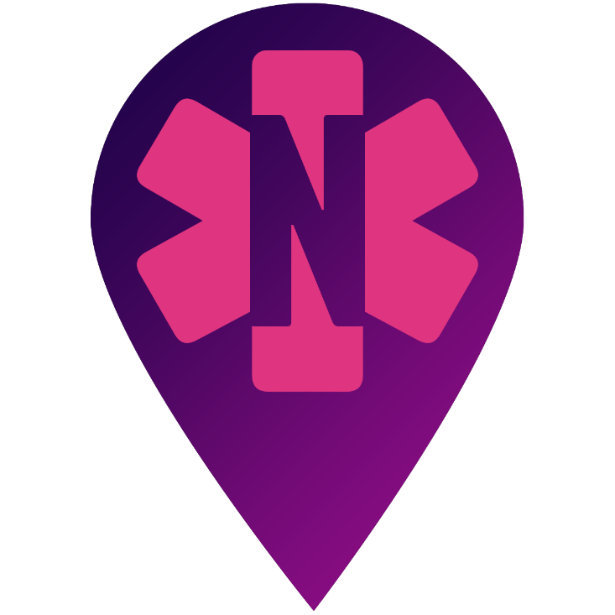
Crowd-sourced Naloxone with NaloxoFind
Training
Note to instructor: The NaloxoFind Trainer app operates on a dedicated training platform and can be used for demonstration purposes. Available on Apple and Google Play.

Slide 2
Background
NaloxoFind is a free app for Apple and Android smartphones.
The app enables anyone around an overdose victim to send anonymous requests to nearby naloxone carriers.
When a request is made, all registered naloxone carriers nearby are notified and the requestor is prompted to dial 911.
If a registered naloxone carrier accepts an alert request, the app automatically guides them to the patient, enabling timely administration naloxone.
NaloxoFind also shows registered public naloxone locations (e.g., wall mounted naloxone) within a two mile radius.
Purpose of NaloxoFind is to augment – not replace - the 911 EMS system.

Slide 3
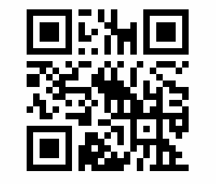
Installation
NaloxoFind is available on the Apple App Store and on Google Play – search for “NaloxoFind” or point your smartphone camera at the barcode below.
Point your smartphone’s camera at the above picture to install NaloxoFind.

Slide 4
NaloxoFind User Types
Anonymous bystanders are users who have downloaded the app but have not registered as naloxone carriers.
Registered naloxone carriers have registered with the app and will be alerted if a nearby user requests help.

Slide 5
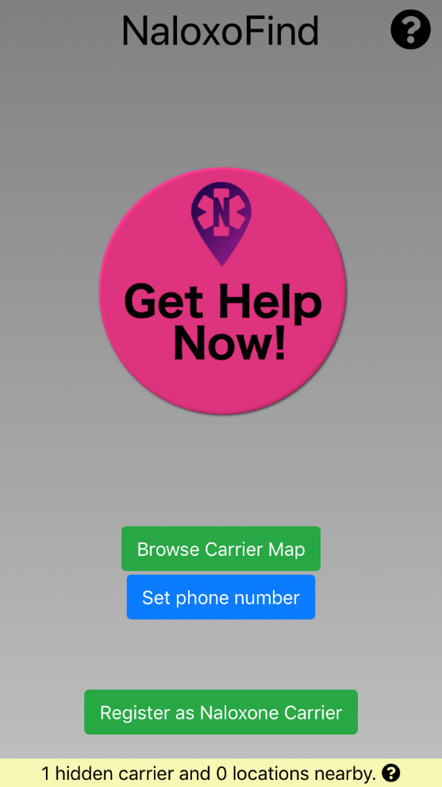
Bystander Usage
Browse registered locations; registered carriers are hidden until a request is accepted.
Set phone number that will be displayed to responders when Get Help button is pressed.

Slide 6
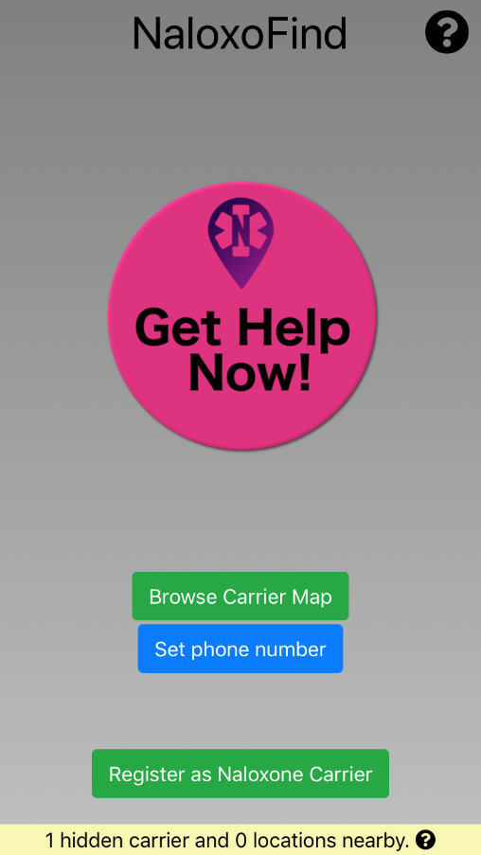
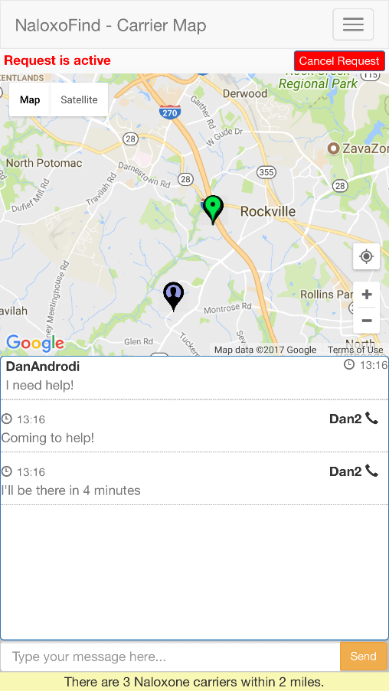
Bystander Usage – Get Help
Cancel request.
Registered public location.
You are here.
Carrier who has accepted a request.
Call this person.
Group chat messaging between requestor and all responders.

Slide 7
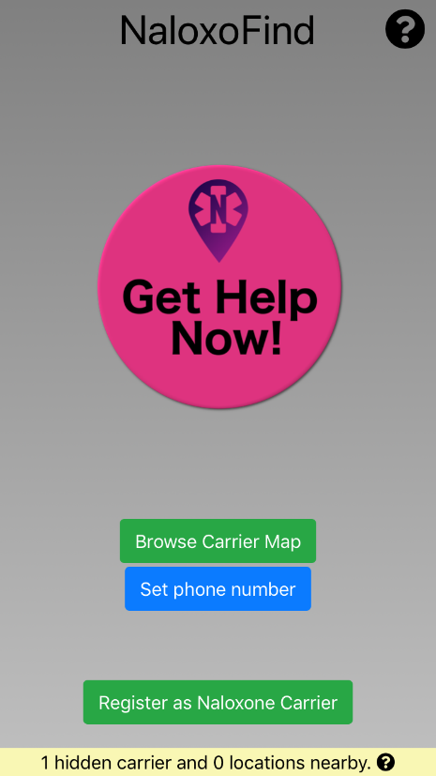
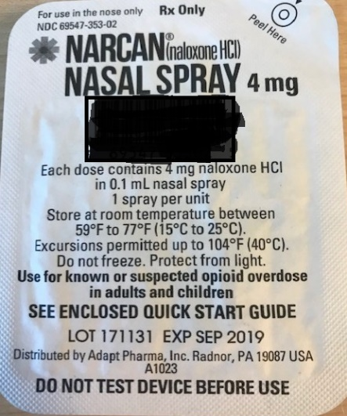
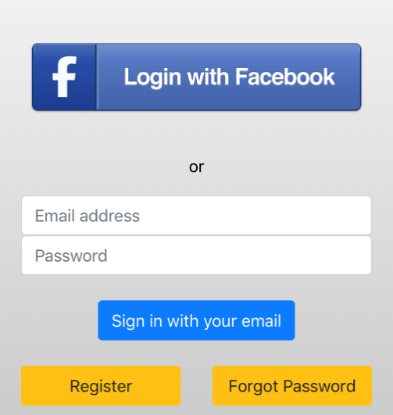
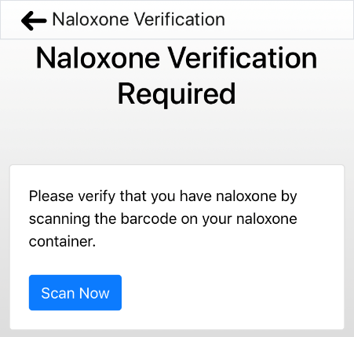
Naloxone Carrier - Registration
Verify that you are a naloxone carrier by scanning the barcode on your naloxone using your camera’s phone.
Login with Facebook or
Click “Register” to create a new account (email verification required).
Click “Yes” to allow Naloxofind to provide alerts and access to your motion.
Barcode
1
2
3
4

Slide 8
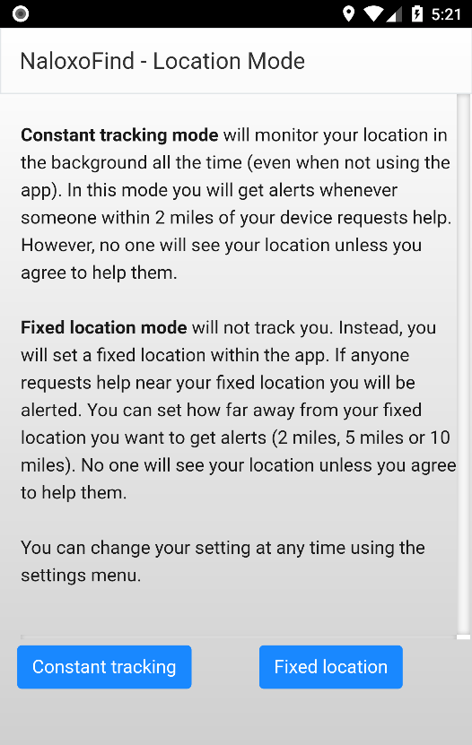
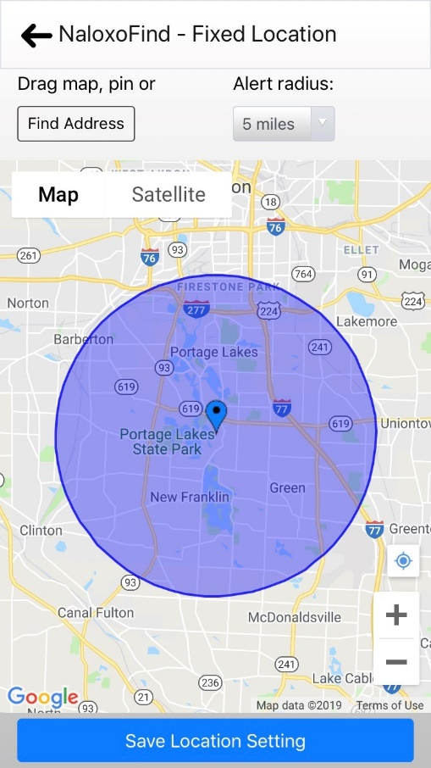
Naloxone Carrier – Registration (Cont’d.)
Fixed location: Drop a pin at a specific location to be alerted if help is requested within a radius you specify.
Click “Find Address” and select an alert radius to drop the pin at a certain place (e.g., “Liberty Island”).
Drag the screen or pin to position by hand.
Save Location Setting.
No location will ever be sent from the device unless you accept a request for help.
Constant tracking (recommended): NaloxoFind monitors your location and alerts you if someone within a two mile radius requests help. No one can see your location or contact you unless you accept a request.

Slide 9
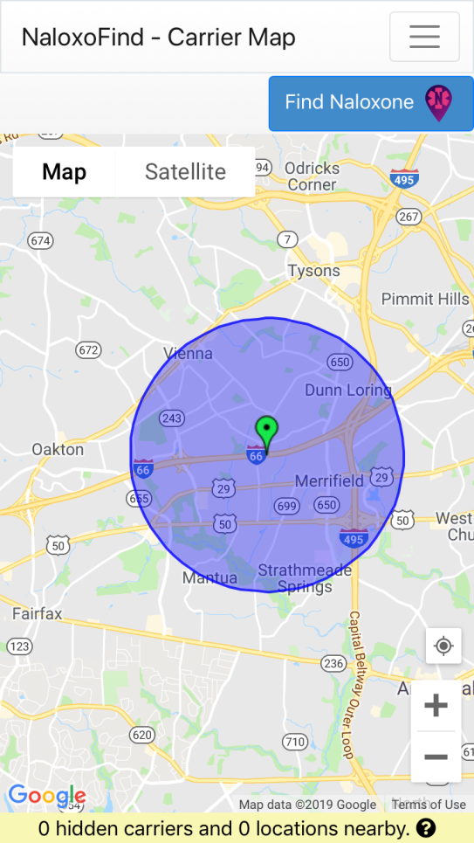
Naloxone Carrier – App Navigation
NaloxoFind Menu.
Find naloxone in an emergency (if you don’t have yours).
Green pin shows your current location.
Blue circle shows the area NaloxoFind is monitoring for alerts.
Total number of carriers (excluding you) and public installations within a two mile radius.

Slide 10
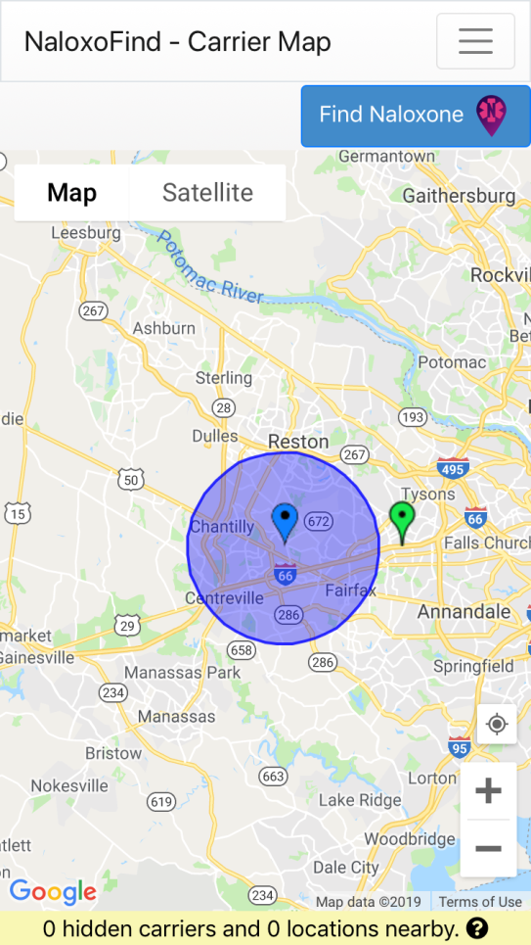
Naloxone Carrier – Fixed vs. Constant
Fixed Location Mode
Constant Tracking Mode
Blue pin shows the fixed location that is being monitored.
Blue circle shows selected alert radius.
Green pin shows your current location.
Blue circle shows a two mile radius – alerts sent within this circle will be received by NaloxoFind.
Green pin shows your current location.

Slide 11
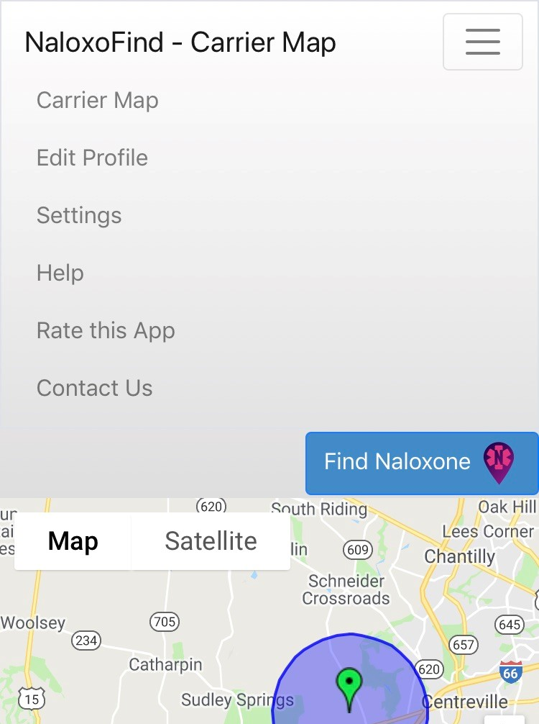
Naloxone Carrier – NaloxoFind Menu
Menu button opens menu.
Navigate back to carrier map.
Update your name and phone number.
Password update; toggle fixed or tracking modes.
NaloxoFind instructions.
Rate NaloxoFind on Apple or Google Play.
Contact Altrix Medical.

Slide 12
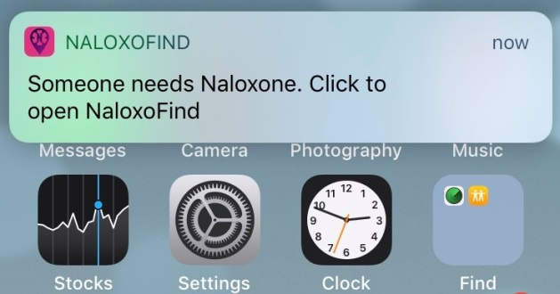
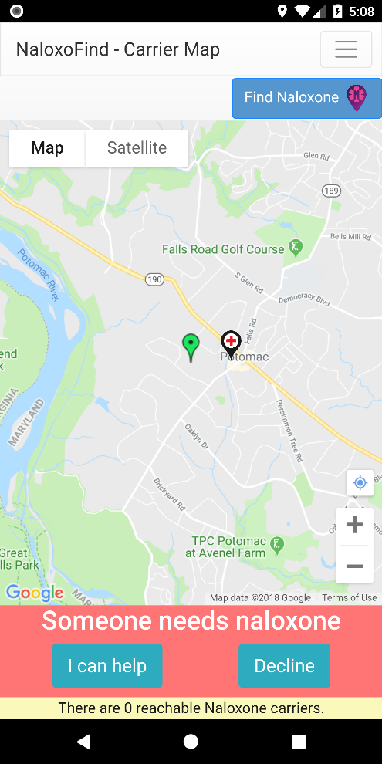
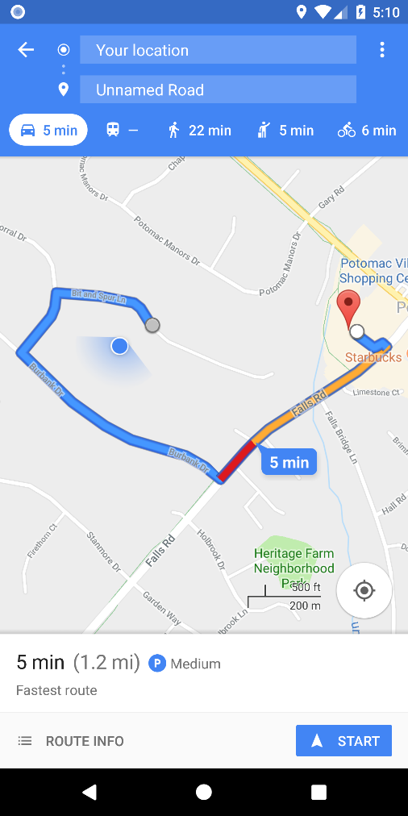
Naloxone Carrier – Alerts
Alert location. Clicking pin provides directions to the location.
Accept or decline request. On acceptance, your location and phone number are shared with requestor and other responders.

Slide 13
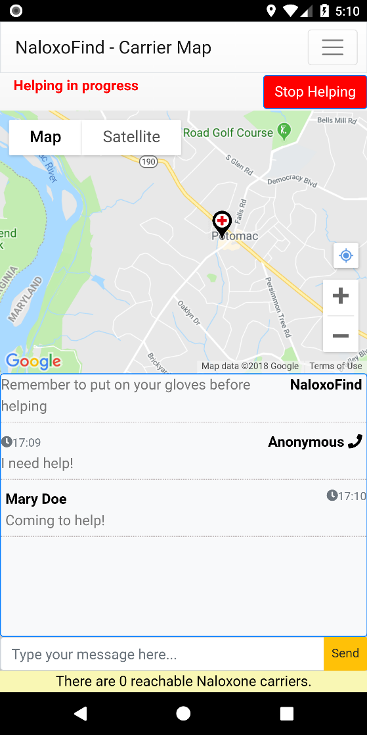
Naloxone Carrier – Accepted Alert
Stop helping.
Registered public location.
You are here.
Call this person.
Group text messaging between requestor and all responders.
Person requesting naloxone. Click for directions.

Slide 14
Questions, Comments, and Feedback
naloxofind.feedback@altrixmedical.com

